Slide 1
Reasoning in Artificial intelligence

Slide 2
What is Reasoning in artificial intelligence?
The reasoning is the mental process of deriving logical conclusion and making predictions from available knowledge, facts, and beliefs. Or we can say, "Reasoning is a way to infer facts from existing data." It is a general process of thinking rationally, to find valid conclusions.
In artificial intelligence, the reasoning is essential so that the machine can also think rationally as a human brain, and can perform like a human.
Types of Reasoning
In AI, reasoning can be divided into the following categories:
Deductive reasoning
Inductive reasoning
Abductive reasoning
Common Sense Reasoning
Monotonic Reasoning
Non-monotonic Reasoning

Slide 3

1. Deductive reasoning:
The mental process of deducing logical conclusions and forming predictions from accessible knowledge, facts, and beliefs is known as reasoning. "Reasoning is a way to deduce facts from existing data," we can state. It is a general method of reasoning to arrive to valid conclusions.
Artificial intelligence requires thinking in order for the machine to think rationally like a human brain.
Deductive reasoning is the process of deducing new information from previously known information that is logically linked. It is a type of legitimate reasoning in which the conclusion of an argument must be true if the premises are true.
In AI, deductive reasoning is a sort of propositional logic that necessitates a number of rules and facts. It's also known as top-down reasoning, and it's the polar opposite of inductive reasoning.
Example:
Premise-1: All the human eats veggies
Premise-2: Suresh is human.
Conclusion: Suresh eats veggies.
The general process of deductive reasoning is given below:

Slide 4
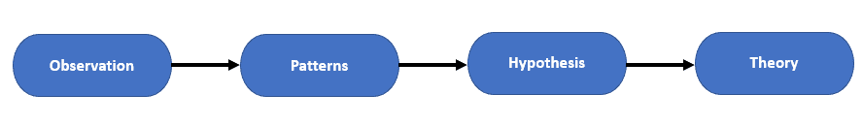
2. Inductive Reasoning:
Inductive reasoning is a type of reasoning that uses the process of generalization to arrive at a conclusion with a limited collection of information. It begins with a set of precise facts or data and ends with a broad assertion or conclusion.
Inductive reasoning, often known as cause-effect reasoning or bottom-up reasoning, is a kind of propositional logic. In inductive reasoning, we use historical evidence or a set of premises to come up with a general rule, the premises of which support the conclusion.
The truth of premises does not ensure the truth of the conclusion in inductive reasoning because premises provide likely grounds for the conclusion.
Example:
Premise: All of the pigeons we have seen in the zoo are white.
Conclusion: Therefore, we can expect all the pigeons to be white.

Slide 5
3. Abductive reasoning:
Abductive reasoning is a type of logical reasoning that begins with a single or several observations and then searches for the most plausible explanation or conclusion for the observation.
The premises do not guarantee the conclusion in abductive reasoning, which is an extension of deductive reasoning.
Example:
Implication: Cricket ground is wet if it is raining
Axiom: Cricket ground is wet.
Conclusion It is raining.
4. Common Sense Reasoning
Common sense thinking is a type of informal reasoning that can be learned through personal experience.
Common Sense thinking mimics the human ability to make educated guesses about occurrences that occur on a daily basis. It runs on heuristic knowledge and heuristic rules and depends on good judgment rather than exact reasoning.
Example:
One person can be at one place at a time.
If I put my hand in a fire, then it will burn.
The preceding two statements are instances of common sense thinking that everyone may comprehend and assume.

Slide 6
5. Monotonic Reasoning:
When using monotonic reasoning, once a conclusion is reached, it will remain the same even if new information is added to the existing knowledge base. Adding knowledge to a monotonic reasoning system does not reduce the number of prepositions that can be deduced.
We can derive a valid conclusion from the relevant information alone to address monotone problems, and it will not be influenced by other factors.
Monotonic reasoning is ineffective for real-time systems because facts change in real time, making monotonic reasoning ineffective.
In typical reasoning systems, monotonic reasoning is applied, and a logic-based system is monotonic. Monotonic reasoning can be used to prove any theorem.
Example:
Earth revolves around the Sun.
It is a fact that cannot be changed, even if we add another sentence to our knowledge base, such as "The moon revolves around the earth" or "The Earth is not round," and so on.
Advantages of Monotonic Reasoning:
In monotonic reasoning, each old proof will always be valid.
If we deduce some facts from existing facts, then it will always be valid.
Disadvantages of Monotonic Reasoning:
Monotonic reasoning cannot be used to represent real-world scenarios.
Hypothesis knowledge cannot be conveyed using monotonic reasoning, hence facts must be correct.
New knowledge from the real world cannot be added because we can only draw inferences from past proofs

Slide 7
6. Non-monotonic Reasoning
Some findings in non-monotonic reasoning may be refuted if we add more information to our knowledge base.
If certain conclusions can be disproved by adding new knowledge to our knowledge base, logic is said to be non-monotonic.
Non-monotonic reasoning deals with models that are partial or uncertain.
"Human perceptions for various things in daily life, " is a basic example of non-monotonic reasoning.
Example: Let suppose the knowledge base contains the following knowledge:
Birds can fly
Penguins cannot fly
Pitty is a bird
In conclusion we can say that “pitty is flying”
However, if we add another line to the knowledge base, such as "Pitty is a penguin," the conclusion "Pitty cannot fly" is invalidated.
Advantages of Non-monotonic Reasoning:
We may utilize non-monotonic reasoning in real-world systems like Robot navigation.
We can choose probabilistic facts or make assumptions in non-monotonic reasoning.
Disadvantages of Non-monotonic Reasoning:
When using non-monotonic reasoning, old truths can be negated by adding new statements.
It can't be used to prove theorems.

Slide 8
Difference between Inductive and Deductive reasoning
Artificial intelligence reasoning can be divided into two types: inductive reasoning and deductive reasoning. Both modes of thinking contain premises and conclusions, but they are incompatible with one another. The following is a list of inductive and deductive reasoning comparisons:
Inductive reasoning involves making a generalization from specific facts and observations, whereas deductive reasoning employs accessible facts, information, or knowledge to draw a correct conclusion.
Deductive reasoning is done from the top down, whereas inductive reasoning is done from the bottom up.
Deductive reasoning leads to a correct conclusion from a generalized assertion, but inductive reasoning leads to a generalization from a specific observation.
The findings in deductive reasoning are certain, whereas the conclusions in inductive reasoning are probabilistic.
Deductive arguments can be valid or invalid, implying that if the premises are true, the conclusion must be true, but inductive arguments can be strong or weak, implying that even if the premises are correct, the conclusion may be untrue.

Slide 9
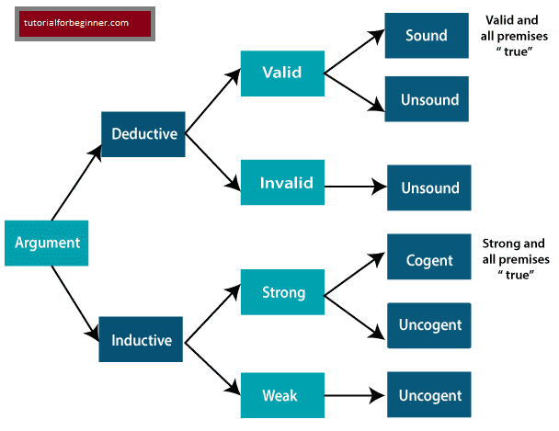
the distinctions between inductive and deductive reasoning can be demonstrated using the picture below:

Slide 10
